Slide 1
NACPO OVERVIEW & UPDATES
10 January 2013

Slide 2
Agenda
2012 Activities and Developments
2013 Initiatives and Goals
Questions

Slide 3
2012 Activities and Developments
Continuing Certification Approach (IFR Kaizen)
Goal of achieving Reduced IFRs
– “Pilots” initiated in select Standard(s)
– SOPs, Training and IT-related systems enhancements under development
– UL Standards only
UL Mark Policy Documents – Revisions
Simplify policy – “doing what is possible unless strictly prohibited”
2nd Century – company name of UL LLC
Virtual Reality-related products
E2E process
Notes:
<>In 2012, major efforts to refine and finalize the “Continued Certification Approach” proposal. The IFR Kaizen Team led by Mike Jorgenson, has been working on a number of actions to initiate pilots for some categories. Pilots have been initiated for UL873/UL60730 (Temp Controllers), UL1640 (Port Power Distribution Panels), UL758 (AWM). For the most part, the approach is limited to UL Standards only, i.e. no CSA, NSF or other non-UL Standards. Traditional IFR approach will continue to be an option.
<>Key UL Mark Policy Documents Revised in 2012 –
Various changes to simplify the UL Mark policy; 2012 goal of identifying all UL Mark Program policies that support ISO/IEC Guide 65 (and the new ISO/IEC 17065), analyzing them to determine those that are mandatory requirements in order to support UL’s accreditations and identifying any policies that could be considered for relaxation or elimination.
Company name change from Underwriters Laboratories Inc to UL LLC (2nd Century driven)
3) 00-CE-P0004 revised for Virtual Reality products → use N/I process consumer & recreational products. In addition, NWGQ/7 category guide card revised “For commercial / industrial equipment establishing a virtual environment (virtual reality) as a function, the physiological effects of cyber sickness, motion sickness and similar side effects have not been investigated”.
4) Changes to move policy information from 00-OP-S0044 into these policy documents; adding 00-OP-S0416 for E2E process. These changes are driven by the pending major revision to 00-OP-S0044, which will be significantly simplified to match the E2E process. Also, the elimination of the requirement for the name of the L3 to be on the Conclusion Page / Test Record Summary. This was changed in policy, but has still not been changed in SOPs controlled by Ops.
Revisions to other documents are noted in the following slides…

Slide 4
2012 Activities and Developments
Acceptance of Products Certified by Others
Medical Products – Conversion to UL from Other Certifiers
Global Test Laboratory (GTLP) Policy Document Rewrite
UL Mark Report Cover Page and Conclusion Templates
Acquired Laboratories (e.g. AQS, Springboard, STR)
Transition Process from DAP TPTDP to UL Laboratory
Site capability assessment
IQA to perform audits
Notes:
Acceptance of Products Certified by Others – There are two initiatives currently underway to explore methods of data acceptance. End Products - A new process for accepting product certifications from other certifiers (also referred to as "converting" the certification to UL) was drafted by PDE org and circulated for comment by the approvers. As part of this process, the other certifiers must be recognized as NRTLs by OSHA, or accredited as CBs by ANSI or SCC. The plans are to create Technical Guidance Documents for each standard in order to provide more details on what additional evaluation should be performed. It is also critical to understand that the certification decision is made before authorizing the use of the Mark, and that any subsequent verification during Follow-Up cannot be portrayed as evidence of certification. There were also questions about the proposed SOP complying with some of the new ISO/IEC 17065 requirements; however, these may be addressed by properly incorporating this process into the scheme. The Pilot SOP was published as 95-PD-S0403; the pilot is effective through 5 April 2013. Key stakeholders have been made aware of the pilot.
Medical Products - Conversion from Other Certifiers to UL Certification – NACPO reviewed a request from the L&HS BU for Medical Products to consider acceptance of other CB’s Certification Report/data for use in promulgating UL certification. The proposal involves accepting a UL60601 2nd Edition certification report from a UL competitor for transitioning to a UL60601 3rd Edition UL File. The new process for acceptance of Competitor’s NRTL/SCC reports for conversion to UL/cUL reports involving the following standards was approved and announced to L&HS BU staff on September 11, 2012: (a) 60601 products transitioning from 2nd to 3rd Edition IEC 60601 coverage, and (b) 61010 “medical only” products (i.e. those that involve Regulatory approval, such as FDA 510k submissions) transitioning from 2nd to 3rd Edition IEC 61010 coverage. This conversion process is being added to the UL Mark Evaluation Policy 00-CE-P0004.
Rewrite of the GTLP Policy Document - Continued work with representatives from Laboratory Operations to update the current GTLP so that it will better align with ISO / IEC 17025 and accommodate laboratory work associated with all business units. The new document is intended to serve as the common baseline policy for the competence of UL testing laboratories across all business units while still accommodating specific criteria that may be mandated within specific programs. Input is being solicited from Business Unit representatives.
UL Mark Report Cover Page and Conclusion Templates– Revisions made to the UL Mark Report Cover Page and Conclusion templates, clarifying the limitations on reproduction of Reports. This new text eliminates the need for authorization to reproduce the Report, but clearly indicates the appropriate uses, and the prohibited uses, of the Report reproductions. The UL and ULC Cover Pages and Conclusion Pages have been updated in GFL and ePublisher, and were available for staff use effective 27 Sep 2012. [Rod – do you have an example of Cover and/or Conclusion page]
Acquired Laboratories - (J. Heinzinger CAR123911168)When a new acquisition is announced via the Acquisitions site on the UL intranet and it was determined to be a current DAP location for the UL Mark program (such as was the case for AQS, Springboard and STR), representatives from DAP, Lab Ops and NACPO will meet to discuss, plan and begin the transition process to determine if SNAP is involved, identify and notify the appropriate laboratory representative, as well as transfer the site from the DAP database to the Scope of Capability database and have the site added to the IQA audit schedule.

Slide 5



2012 Activities and Developments
2012 Activities and Developments
Record Retention
Policy 00-CE-S0030 revised: correspondence = 5 year minimum retention (e.g. NOA, ATL).
NOAs / Authorization Pages Signatory
Intercompany Accreditation Agreements (IAAs)
Corporate, BU and Shared Services Project
NACPO – Product Safety
Notes:
Record Retention – Legal had clarified their position on record retention in relaxing the permanent storage requirements for some records. The MPC determined that it is not essential to retain some records. NOA is only a temporary authorization that is needed until the final Procedure and Report are made available (usually less than one day following the certification decision). Another example is the ATL, which is kept for about 6 months and then purged. Record Retention policy was revised. Operations raised the concern that implementing this policy change is going to be very difficult. Dave Bennett has developed some preliminary plans to identify and purge records older than five years, but executing those plans was very resource intensive. The uncertainty about future platforms (moving away from eCommunications, moving from DMS to SharePoint, etc.) added another layer of complexity. While there has been some preliminary work done on possible architectures, those initiatives were not pursued due to budget reasons. Dave Bennett has formed a team to look at purging of old correspondence records, as well as methods to tag future records for easier destruction after the five year retention period; however, the initiative to purge these records is on hold, pending the current work by IT to move all records to SharePoint. The final decision of the MPC was to leave the policy as it is currently written (retention period of a minimum of five years for correspondence records, as identified in 00-CE-S0030), and revisit record retention after IT has completed the movement of all records to SharePoint. At that time, tags or other identifiers can be implemented, and a policy change to eliminate the "minimum" modifier could be considered for all records on a going forward basis.
NOAs / Authorization Pages Signatory - Aligned signatory requirements for NOA and Authorization Page to have BC’s name on both.
Intercompany Accreditation Agreements (IAAs) - Initial implementation of the Intercompany Accreditation Agreements (IAAs) that are needed to show organizational control by UL LLC in the 2nd Century legal entity structure. This involved an initial execution of IAAs between UL LLC and all legal entities in existence as of 1 Jan 2012; however, no additional IAAs have been executed as new entities have been created and/or undergone name changes. This was highlighted in the recent IQA audit, and a CAR is being addressed. For 2013, further implementation of IAAs, including better mechanism for informing staff of the need to follow all UL Mark policies and procedures, regardless of their legal entity
Bucket List Project – Effective January 2013, CPO/Accreditations were allocated to the five Business Units to help drive greater consistency and efficiencies across our entire organization. This reallocation will allow the organization to have better line of site to the individual BU P&Ls (Profit & Loss Statements) as well as further enable better alignment of resources, goals and objectives. NACPO will support Product Safety (via Ray Burg) even though we continue to support other programs under other BU’s, e.g. Water Systems (L&HS).

Slide 6
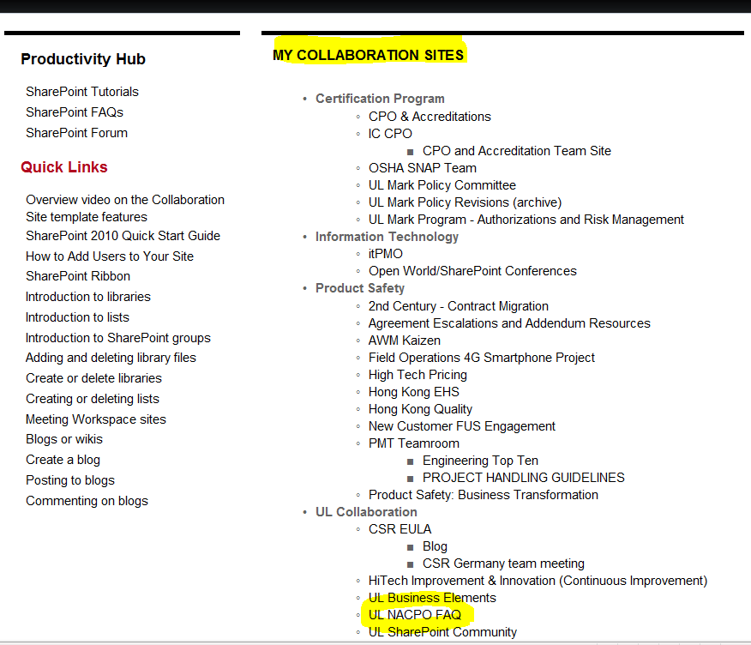
2012 Activities and Developments
NACPO FAQs on SharePoint
Notes:
NACPO FAQs on SharePoint – Moved from NACPO webpage; accessible to all UL staff with ability to seek clarification to UL Mark Policy. Another communication mechanism for staff. Plans to expand FAQs, e.g. Continuing Certification, ISO 17065 impacts to policy, etc. Encourage others to use site.

Slide 7
Agenda
2012 Activities and Developments
2013 Initiatives and Goals
Questions

Slide 8
2013 Initiatives and Goals
Revisions to UL Mark Policy documents w.r.t. 17065/17025 Stds
UL Mark Certification Policy Training – update and implement
Impartiality, Safeguard Mechanism – ISO 17065
Convergence of UL Mark and ULC Mark Programs
Transition Policy for Acquired Test Labs w.r.t 17025
Proactive Support of New Businesses and Business Units
Medical (L&HS) – Certification Process Redesign
2012 AMRs’ of UL Mark Programs underway
IQA Audits is key AMR input
Notes:
UL Mark Policy Revisions w.r.t. 17065/17025 – (Rod & Jim)
UL Mark Training – (Jim) based on goal above
Impartiality Safeguard Mechanism – (Bill, Rod, Walt)
Convergence of UL Mark and ULC Mark Programs – (Mike)
Transition Policy for Acquired Test Lab w.r.t. 17025 – (Jim)
Proactive Support of New Businesses and BU’s – (BC and NACPO team)
2012 AMRs – (BC and NACPO team)

Slide 9
THANK YOU.
Questions…

